Slide 1

Design Patterns
Unit II-Chapter No. : 7- design Patterns

Slide 2

Topic Learning Outcomes
Explain java design patterns
Apply design pattern to solve a given problem
Apply suitable design pattern solution for a given problem specification
School of Computer Science & Engineering

Slide 3

Content
Introduction to design patterns
Creational Patterns: Singleton pattern, Factory method pattern
Behaviour pattern: Strategy pattern, Template method pattern
Structural pattern: Adapter pattern, Composite pattern.
School of Computer Science & Engineering

Slide 4
Introduction
The design pattern is a general reusable solution to a commonly occurring problem in software design.
OR , The design pattern are just a formal language to define common ways to solve software engineering problems.
We (most people)designed solutions (class diagrams) using design patterns, without knowing that they are.
People will naturally come up with solutions that will fit into a design pattern on their own, but the design patterns help to define terminology and standard ideas that can be helpful.
The main benefit of design patterns is that, they are ideas that can be defined in ways that are repeatedly useful (reusable).
School of Computer Science & Engineering

Slide 5
Design Patterns: Limitations
One of the limitation (due to reusability) Is that, the design patterns stop people from coming up with proper solution to a specific problem.
Instead of thinking about how to solve that particular problem, people try applying one design pattern after the other.
However, if we know language of design patterns (UML) and standard design patterns, we can take advantage of reusability and we can design our own solutions.
School of Computer Science & Engineering

Slide 6
Creational Design Pattern:
In software engineering, creational design patterns are design patterns that deal with object creation mechanisms, trying to create objects in a manner suitable to the situation.
  Singleton pattern,
  Factory method pattern
School of Computer Science & Engineering

Slide 7
Singleton pattern
Singleton pattern is one of the simplest design patterns in Java, as this pattern provides one of the best ways to create an object.
This pattern involves a single class which is responsible to create an object while making sure that only single object gets created.
This class provides a way to access its only object which can be accessed directly without need to instantiate the object of the class.
School of Computer Science & Engineering

Slide 8
Singleton pattern: implementation
create a SingleObject class, it has its constructor as private and have a static instance of itself.
SingleObject class provides a static method to get its static instance to outside world.
SingletonPatternDemo class will use SingleObject class to get a SingleObject object.
School of Computer Science & Engineering

Slide 9
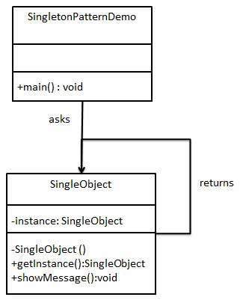
Singleton pattern: class diagram
School of Computer Science & Engineering

Slide 10
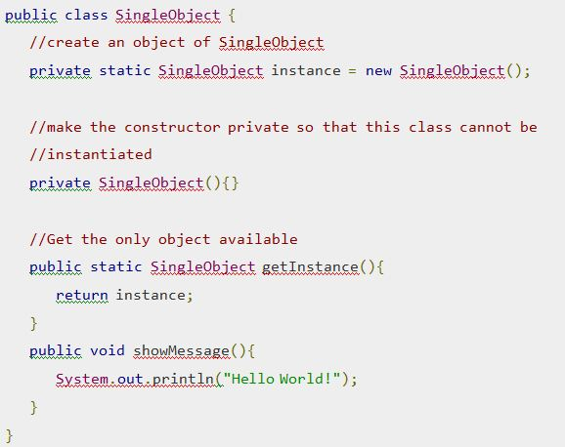
Singleton pattern: code
Step 1
  Create a Singleton Class.
  SingleObject.java
School of Computer Science & Engineering

Slide 11
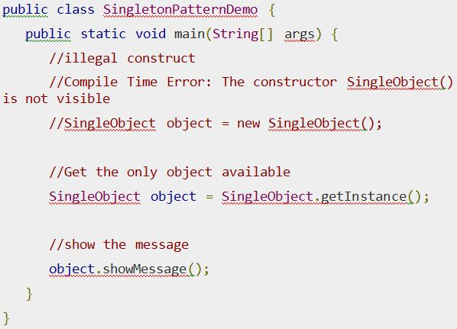
Step 2
  Get the only object from the singleton class.
  SingletonPatternDemo.java
School of Computer Science & Engineering

Slide 12
Step 3
  Verify the output.
  Hello World!
School of Computer Science & Engineering

Slide 13
Design Pattern - Factory Pattern
Factory pattern is one of most used design pattern in Java.
In Factory pattern, we create object without exposing the creation logic to the client and refer to newly created object using a common interface.
School of Computer Science & Engineering

Slide 14
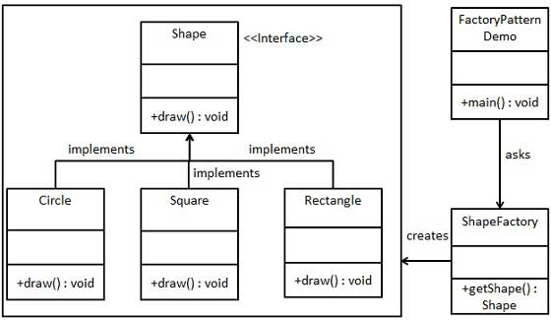
Factory Pattern: class diagram
School of Computer Science & Engineering

Slide 15
Factory Pattern: Implementation
create a Shape interface and concrete classes implementing the Shape interface.
A factory class ShapeFactory is defined as a next step.
FactoryPatternDemo, our demo class will use ShapeFactory to get a Shapeobject.
It will pass information (CIRCLE / RECTANGLE / SQUARE) toShapeFactory to get the type of object it needs.
School of Computer Science & Engineering

Slide 16
Step 1
  Create an interface.
  Shape.java
public interface Shape { void draw();}
Step 2
  Create concrete classes implementing the same interface.
Rectangle.java
  public class Rectangle implements Shape {
  public void draw() {
  System.out.println("Inside Rectangle::draw() method."); } }
School of Computer Science & Engineering

Slide 17
Factory Pattern: implementation
Square.java
public class Square implements Shape {
public void draw() { System.out.println("Inside Square::draw() method."); }}
Circle.java
public class Circle implements Shape {
public void draw() { System.out.println("Inside Circle::draw() method."); }}
School of Computer Science & Engineering

Slide 18
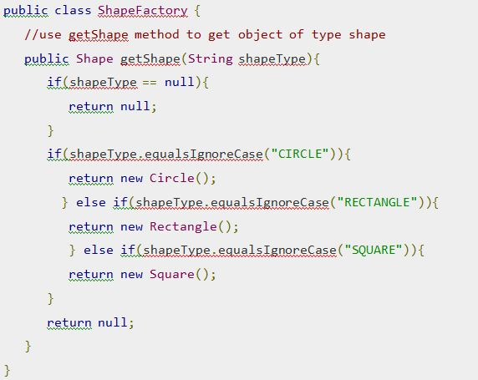
ShapeFactory.java
Step 3: Create a Factory to generate object of concrete class based on given information.
School of Computer Science & Engineering

Slide 19
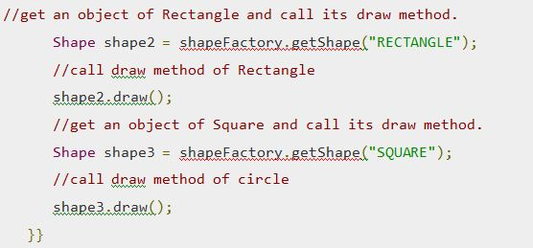
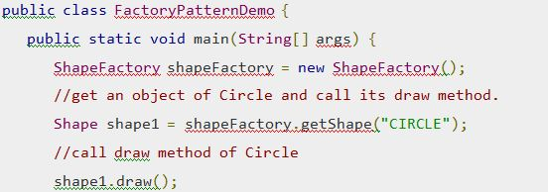
Step 4
  Use the Factory to get object of concrete class by passing an information such as type.
  FactoryPatternDemo.java
School of Computer Science & Engineering

Slide 20
Factory Pattern: output
Step 5
Verify the output.
  Inside Circle::draw() method.
  Inside Rectangle::draw() method.
  Inside Square::draw() method.
School of Computer Science & Engineering

Slide 21
Behaviour Pattern: strategy pattern
In Strategy pattern, a class behaviour or its algorithm can be changed at run time.
  Example
  Base class reference variable/interface reference variable can be assigned sub class object
  The type of the object assigned decides which version (object) method has to be called.
In Strategy pattern, we create objects which represent various strategies and a context object whose behavior varies as per its strategy object.
The strategy object changes the executing algorithm of the context object.
School of Computer Science & Engineering

Slide 22
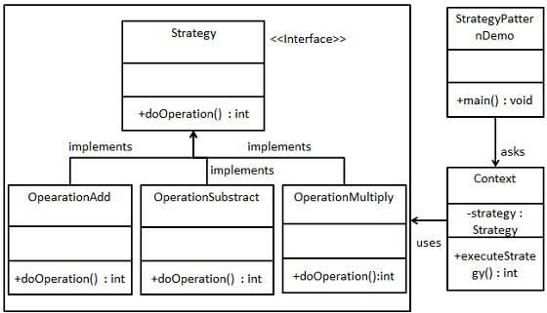
Strategy pattern: class diagram
School of Computer Science & Engineering

Slide 23
Strategy pattern: implementation
Steps
create a Strategy interface defining an action
Create concrete strategy classes implementing the Strategy interface
Context is a class which uses a Strategy.
Create StrategyPatternDemo, a demo class, that will use Context and strategy objects to demonstrate change in Context behaviour based on strategy it deploys or uses.
School of Computer Science & Engineering

Slide 24
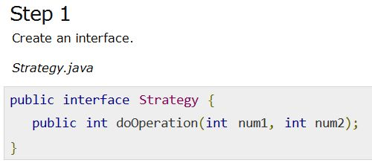
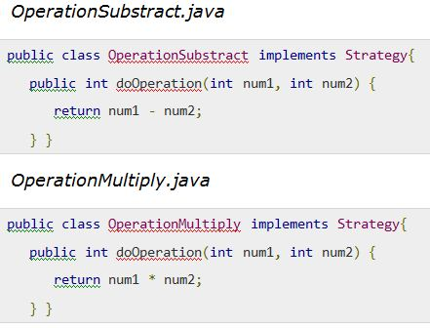
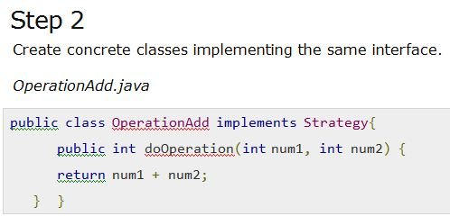
Strategy pattern: code
School of Computer Science & Engineering

Slide 25
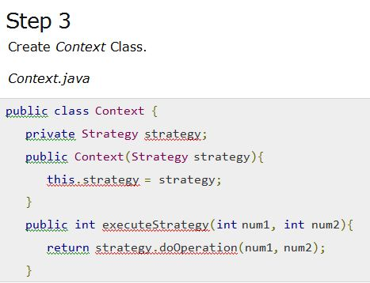
Strategy pattern: code
School of Computer Science & Engineering

Slide 26
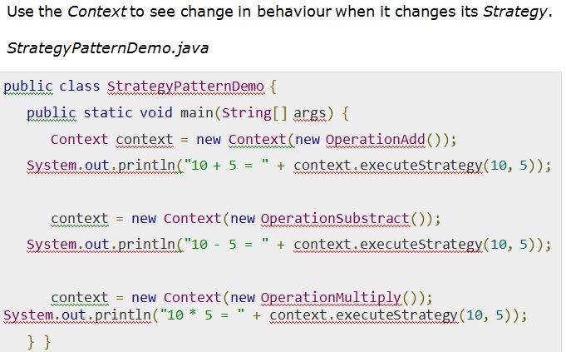
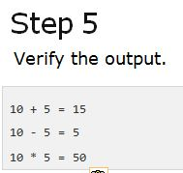
Strategy pattern: code
School of Computer Science & Engineering

Slide 27
Behaviour pattern: Template pattern
In Template pattern, an abstract class exposes defined way(s)/template(s) to execute its methods
Its subclasses can override the method implementation as per need but the invocation is to be in the same way as defined by an abstract class
School of Computer Science & Engineering

Slide 28
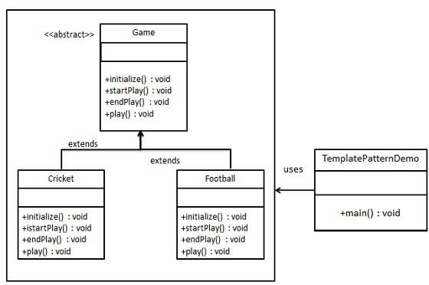
Template pattern: class diagram
School of Computer Science & Engineering

Slide 29
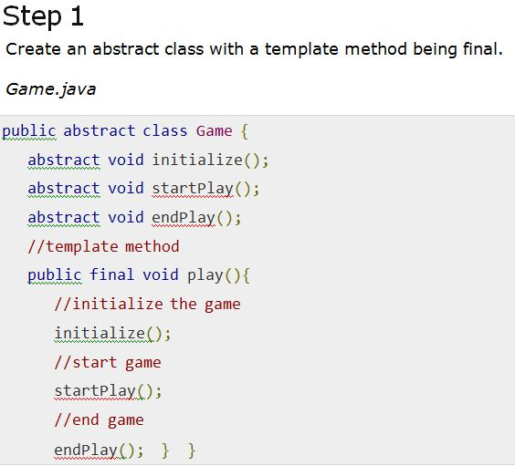
Template pattern: implementation
School of Computer Science & Engineering

Slide 30
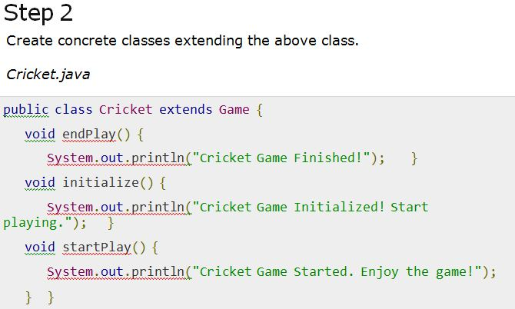
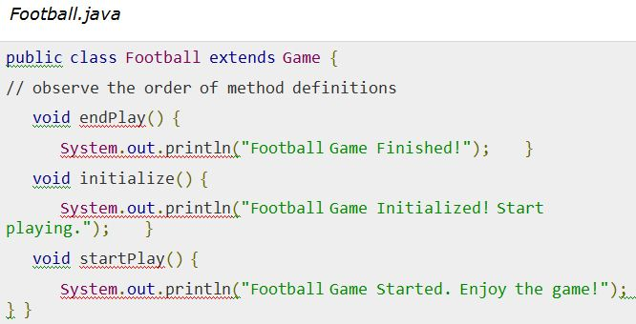
Template Pattern
School of Computer Science & Engineering

Slide 31
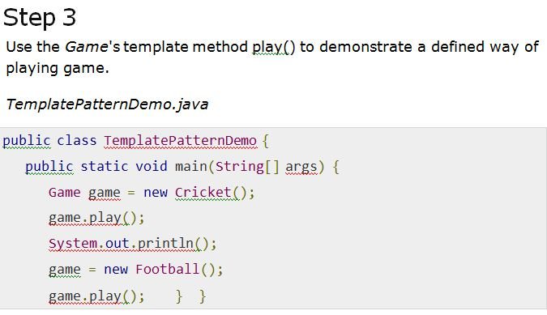
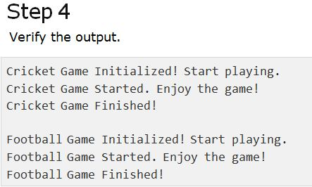
Template Pattern
School of Computer Science & Engineering

Slide 32
Structural pattern: Adapter Pattern
Adapter pattern works as a bridge between two incompatible interfaces.
this pattern combines the capability of two independent interfaces.
This pattern involves a single class which is responsible to join functionalities of independent or incompatible interfaces
A real life example could be a case of card reader which acts as an adapter between memory card and a laptop. You plugin the memory card into card reader and card reader into the laptop so that memory card can be read via laptop.
School of Computer Science & Engineering

Slide 33
Adapter Pattern
Consider the following scenario:
We have a MediaPlayer interface and a concrete class AudioPlayer implementing the MediaPlayer interface and AudioPlayer can play mp3 format audio files by default.
We are having another interface AdvancedMediaPlayer and concrete classes implementing the AdvancedMediaPlayer interface. These classes can play vlc and mp4 format files.
School of Computer Science & Engineering

Slide 34
Adapter Pattern
Now we wanted to make AudioPlayer to play other formats as well. To attain this, we have created an adapter class MediaAdapter which implements the MediaPlayerinterface and uses AdvancedMediaPlayer objects to play the required format.
AudioPlayer uses the adapter class MediaAdapter passing it the desired audio type without knowing the actual class which can play the desired format. AdapterPatternDemo, our demo class will use AudioPlayer class to play various formats.
School of Computer Science & Engineering

Slide 35
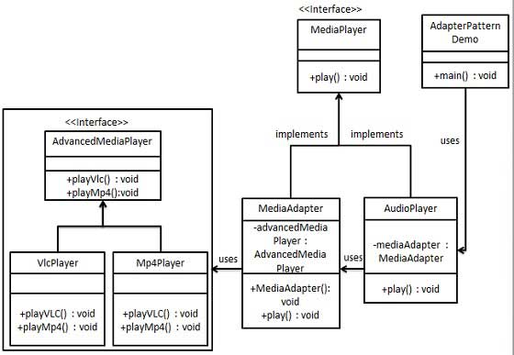
Adapter Pattern: class diagram
School of Computer Science & Engineering

Slide 36
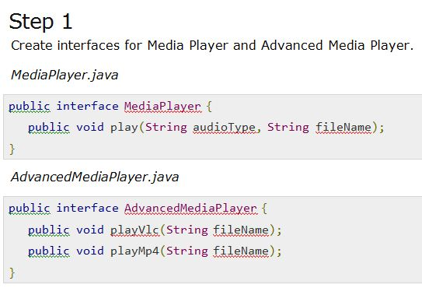
Adapter Pattern: implementation
School of Computer Science & Engineering

Slide 37
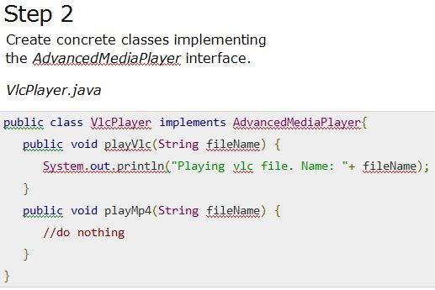
Adapter Pattern: implementation
School of Computer Science & Engineering

Slide 38
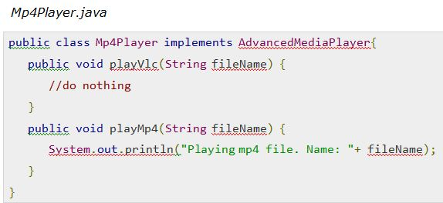
Adapter Pattern : implementation
School of Computer Science & Engineering

Slide 39
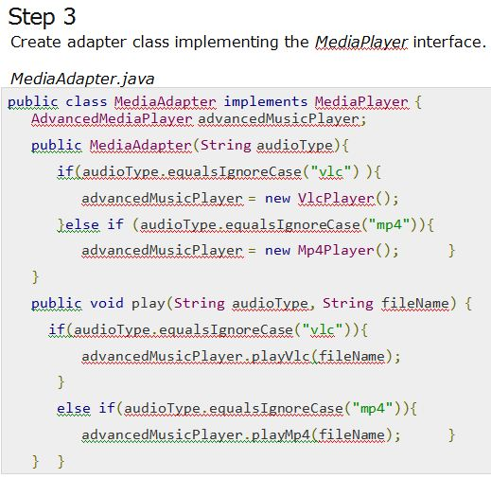
Adapter Pattern : implementation
School of Computer Science & Engineering

Slide 40
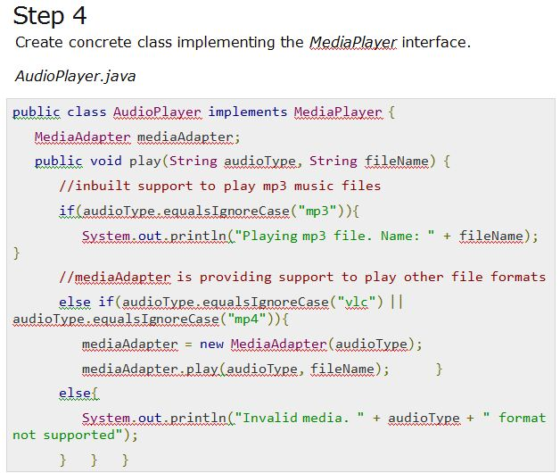
Adapter Pattern
School of Computer Science & Engineering

Slide 41
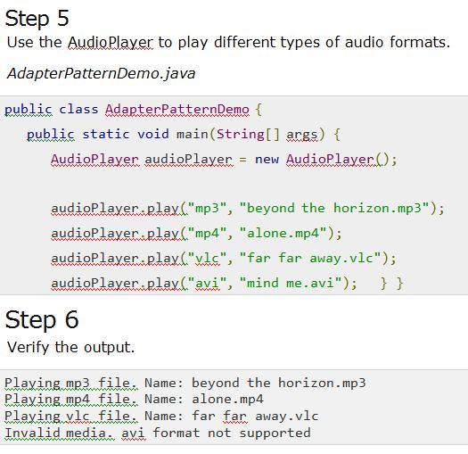
Adapter Pattern
School of Computer Science & Engineering

Slide 42
Structural Pattern: Composite Pattern
Composite pattern is used where we need to treat a group of objects in similar way as a single object.
Composite pattern composes objects in term of a tree structure to represent part as well as whole hierarchy.
This pattern creates a class that contains group of its own objects.
This class provides ways to modify its group of same objects.
School of Computer Science & Engineering

Slide 43
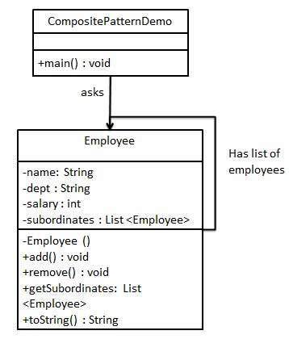
Structural Pattern: class diagram
School of Computer Science & Engineering

Slide 44
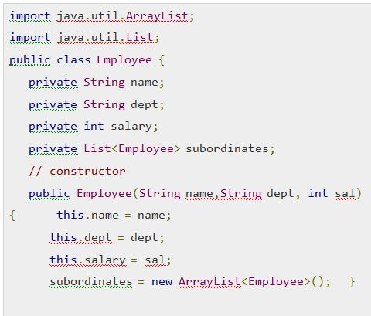
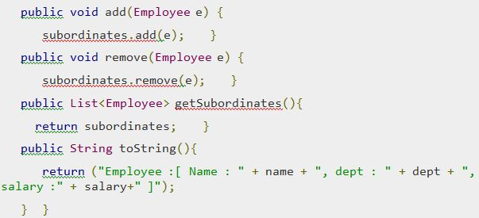
Composite Pattern: Implementation
Step 1: Create Employee class having list Employee objects.
Employee.java
School of Computer Science & Engineering

Slide 45
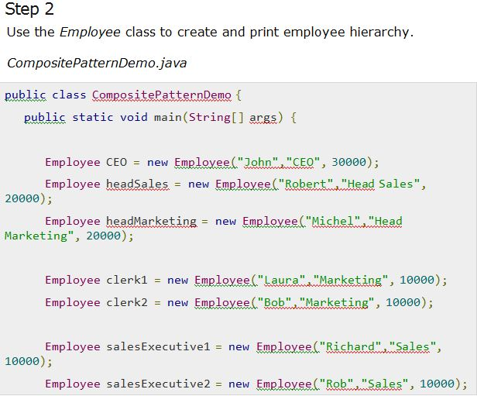
Composite Pattern
School of Computer Science & Engineering

Slide 46
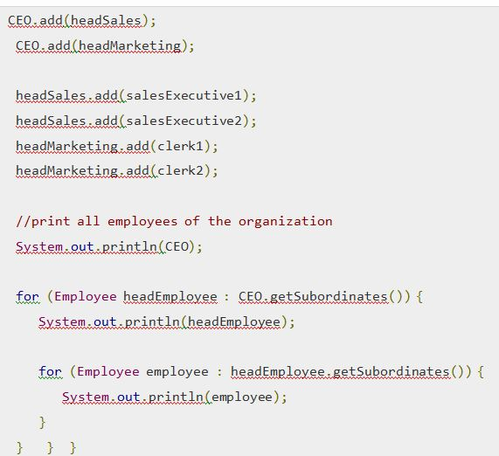
Composite Pattern
School of Computer Science & Engineering

Slide 47
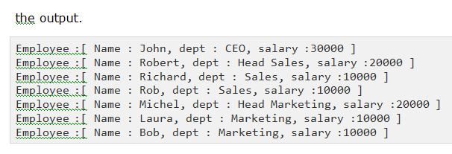
Composite Pattern
School of Computer Science & Engineering

Slide 48
Assignment
Identify suitable design pattern for the following scenario and draw class diagram
A company pays its employees on a weekly basis. The employees are of four types: Salaried employees are paid a fixed weekly salary regardless of the number of hours worked, hourly employees are paid by the hour and receive overtime pay (i.e., 1.5 times their hourly salary rate) for all hours worked in excess of 40 hours, commission employees are paid a percentage of their sales and base salaried commission employees receive a base salary plus a percentage of their sales. For the current pay period, the company has decided to reward salaried-commission employees by adding 10% to their base salaries. Write a java application that performs payroll calculations.
School of Computer Science & Engineering

Slide 49
Adapter Pattern
School of Computer Science & Engineering

Slide 50
Adapter Pattern
School of Computer Science & Engineering

